Slide 1

CISC360 Computer Architecture
Lesson 5
RAID Arrays and Storage Area Networks

Slide 2

Network Attached Storage
14" » 10" » 8" » 5.25" » 3.5" » 2.5" » 1.8" » 1.3" » . . .
high bandwidth disk systems based on arrays of disks
High Performance
Storage Service
on a High Speed
Network
Decreasing Disk Diameters
Network provides
well defined physical
and logical interfaces:
separate CPU and
storage system!
Network File Services
OS structures
supporting remote
file access
3 Mb/s » 10Mb/s » 50 Mb/s » 100 Mb/s » 1 Gb/s » 10 Gb/s
networks capable of sustaining high bandwidth transfers
Increasing Network Bandwidth

Slide 3
Manufacturing Advantages of Disk Arrays
Conventional: 4 disk designs
3.5”
5.25”
10”
14”
Low End
High End
Disk Array: 1 disk design
3.5”

Slide 4
Replace Small # of Large Disks with Large # of Small Disks! (1988 Disks)
IBM 3390 (K)
20 GBytes
97 cu. ft.
3 KW
15 MB/s
600 I/Os/s
250 KHrs
$250K
IBM 3.5" 0061
320 MBytes
0.1 cu. ft.
11 W
1.5 MB/s
55 I/Os/s
50 KHrs
$2K
x70
23 GBytes
11 cu. ft.
1 KW
120 MB/s
3900 IOs/s
??? Hrs
$150K
Data Capacity
Volume
Power
Data Rate
I/O Rate
MTTF
Cost

Slide 5
Array Reliability
Reliability of N disks = Reliability of 1 Disk ÷ N
  50,000 Hours ÷ 70 disks = 700 hours
Disk system MTTF: Drops from 6 years to 1 month!
• Arrays (without redundancy) too unreliable to be useful!
Hot spares support reconstruction in parallel with access: very high media availability can be achieved

Slide 6

Redundant Arrays of Inexpensive Disks
• Files are "striped" across multiple spindles
• Redundancy yields high data availability
Disks will fail
Contents reconstructed from data redundantly stored in the array
Capacity penalty to store it
Bandwidth penalty to update
Mirroring/Shadowing (high capacity cost)
Horizontal Hamming Codes (overkill)
Parity & Reed-Solomon Codes
Failure Prediction (no capacity overhead!)
Techniques:

Slide 7
Redundant Arrays of Disks
RAID 1: Disk Mirroring/Shadowing
recovery
group
• Each disk is fully duplicated onto its "shadow"
Very high availability can be achieved
• Bandwidth sacrifice on write:
Logical write = two physical writes
• Reads may be optimized
• Most expensive solution: 100% capacity overhead
Targeted for high I/O rate , high availability environments

Slide 8
RAID-3: Parity Disk
10010011
11001101
10010011
. . .
P
logical record
1
0
0
1
0
0
1
1
1
1
0
0
1
1
0
1
1
0
0
1
0
0
1
1
0
0
1
1
0
0
0
0
Striped physical
records
• Parity computed across recovery group to protect against
hard disk failures
33% capacity cost for parity in this configuration
wider arrays reduce capacity costs, decrease expected availability,
increase reconstruction time
• Arms logically synchronized, spindles rotationally synchronized
logically a single high capacity, high transfer rate disk
Targeted for high bandwidth applications: Scientific, Image Processing

Slide 9

RAID 5+: High I/O Rate Parity
D0
D1
D2
D3
P
Increasing
Logical
Disk
Addresses
A logical write
becomes four
physical I/Os
Independent writes
possible because of
interleaved parity
Reed-Solomon
Codes ("Q") for
protection during
reconstruction
D4
D5
D6
P
D7
D8
D9
P
D10
D11
D12
P
D13
D14
D15
Stripe
P
D16
D17
D18
D19
Targeted for mixed
applications
Stripe
Unit
D20
D21
D22
D23
P
.
.
.
.
.
.
.
.
.
.
.
.
.
.
.
Disk Columns

Slide 10
Problems of RAID-5 Arrays:
Small Writes
RAID-5: Small Write Algorithm
1 Logical Write = 2 Physical Reads + 2 Physical Writes
D0'
D0
D1
D2
D3
P
new
data
old
data
old
parity
(1. Read)
(2. Read)
+
XOR
+
XOR
(3. Write)
(4. Write)
D0'
D1
D2
D3
P'

Slide 11
Subsystem Organization
host
host
adapter
array
controller
single board
disk
controller
manages interface
to host, DMA
single board
disk
controller
control, buffering,
parity logic
single board
disk
controller
physical device
control
striping software off-loaded from
host to array controller
no applications modifications
no reduction of host performance
single board
disk
controller
often piggy-backed
in small format devices

Slide 12
System Availability: Orthogonal RAIDs
Array
Controller
String
Controller
. . .
String
Controller
. . .
String
Controller
. . .
String
Controller
. . .
String
Controller
. . .
String
Controller
. . .
Data Recovery Group: unit of data redundancy
Redundant Support Components: fans, power supplies, controller, cables
End to End Data Integrity: internal parity protected data paths

Slide 13
System-Level Availability
host
host
I/O Controller
Fully dual redundant
I/O Controller
Array Controller
Array Controller
. . .
. . .
. . .
Goal: No Single
Points of
Failure
. . .
. . .
.
.
.
with duplicated paths, higher performance can be
obtained when there are no failures
Recovery
Group

Slide 14
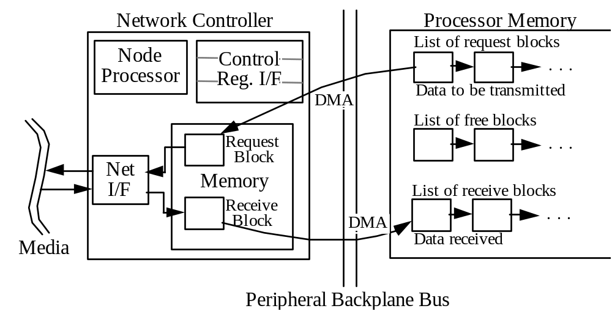
Communications Networks
Performance limiting factors are memory system, OS overhead
Send/receive queues in processor memories
Network controller copies back and forth via DMA
No host intervention needed
Interrupt host when message sent or received

Slide 15
Storage Area Networks (SAN)
Next generation of storage technology
Breaks the bonds of SCSI channel length
SAN Advantages
  Long-haul
  Technology diversity
  Multi-vendor
  Multi-system
Disadvantages
  Complexity
  Immature technology

Slide 16
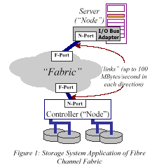
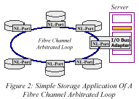
What is a SAN? FC-AL?

Slide 17
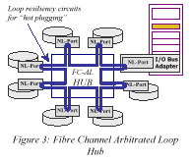
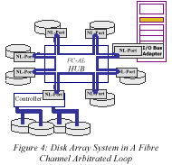
FC-AL Networking

Slide 18
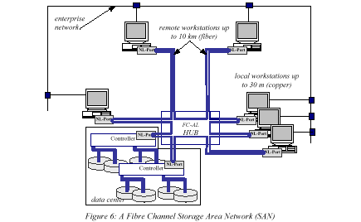
Fibre Channel SAN

Slide 19
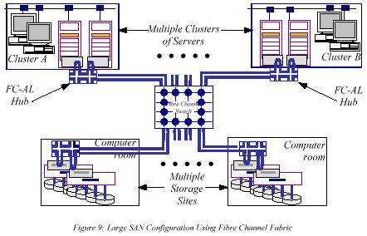
Disaster Recovery using SANs

Slide 20
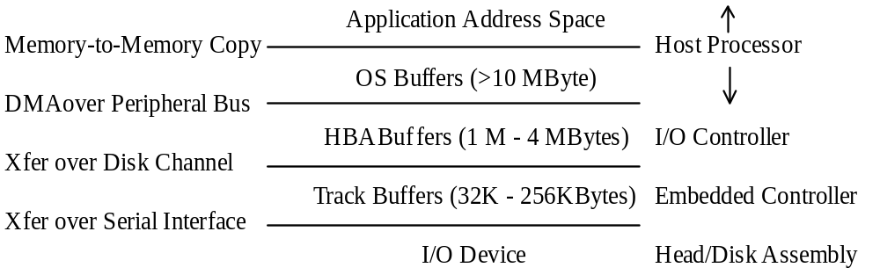
I/O Data Flow
Impediment to high performance: multiple copies,
complex hierarchy

Slide 21
ABCs of UNIX File Systems
Key Issues
  File vs. Raw I/O
  File Cache Size Policy
  Write Policy
  Local Disk vs. Server Disk
File vs. Raw:
  File system access is the norm: standard policies apply
  Raw: alternate I/O system to avoid file system, used by data bases
File Cache Size Policy
  % of main memory dedicated to file cache is fixed at system generation (e.g., 10%)
  % of main memory for file cache varies depending on amount of file I/O (e.g., up to 80%)

Slide 22
ABCs of UNIX File Systems
Write Policy
  File Storage should be permanent; either write immediately or flush file cache after fixed period (e.g., 30 seconds)
  Write Through with Write Buffer
  Write Back
  Write Buffer often confused with Write Back
    Write Through with Write Buffer, all writes go to disk
    Write Through with Write Buffer, writes are asynchronous, so processor doesn’t have to wait for disk write
    Write Back will combine multiple writes to same page; hence can be called Write Cancelling

Slide 23
ABCs of UNIX File Systems
Local vs. Server
  Unix File systems have historically had different policies
  (and even file sytems) for local client vs. remote server
  NFS local disk allows 30 second delay to flush writes
  NFS server disk writes through to disk on file close
  Cache coherency problem if allow clients to have file caches in addition to server file cache
    NFS just writes through on file close
    Stateless protocol: periodically get new copies of file blocks
    Other file systems use cache coherency with write back to check state and selectively invalidate or update

